Slide 1



Quora Question Answering: A Comprehensive Approach
This project aims to develop a state-of-the-art question-answering model using the Quora Question Answer Dataset. We explore various NLP models to create an AI system capable of understanding and generating human-like responses.
We start by performing extensive data preprocessing, including text cleaning, tokenization, and sentence segmentation.
Next, we experiment with different language models such as BERT, GPT-2, and Transformer to train our question-answering model.
Finally, we evaluate the performance of our model using metrics like accuracy, precision, and recall to ensure the effectiveness of our comprehensive approach.
BY: GURBANI KAUR

Slide 2
Quora Question Answer Dataset
Dataset Overview
Data Preprocessing
Dataset Features
The Quora Question Answer Dataset contains millions of question-answer pairs collected from the popular question-and-answer platform Quora. Each pair includes a question and its corresponding answer.
The dataset underwent thorough preprocessing to clean and prepare it for model training. This involved removing irrelevant information, handling special characters, and tokenizing the text.
The dataset provides valuable insights into how users ask and answer questions, offering a rich resource for developing natural language processing models.

Slide 3

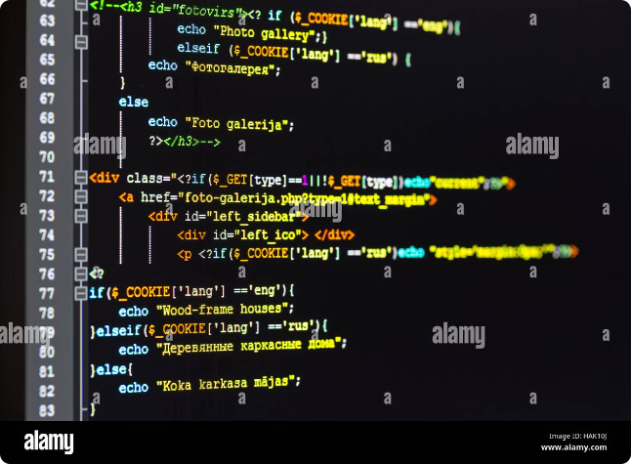
NLP Models Explored
1
BERT
Bidirectional Encoder Representations from Transformers (BERT) is a powerful language model known for its ability to capture contextual information.
2
T5
Text-to-Text Transfer Transformer (T5) is a versatile model that excels in various natural language processing tasks, including question answering.
3
GPT
Generative Pre-trained Transformer (GPT) is a generative language model that can generate coherent and contextually relevant text.

Slide 4

Evaluation Metrics
Metric
Description
ROUGE
Measures the overlap between predicted and actual answers based on n-gram matching.
BLEU
Evaluates the quality of machine translation by comparing the generated text to reference translations.
F1-score
Calculates the harmonic mean of precision and recall, providing a balanced measure of model performance.

Slide 5





T5 Model Performance
High F1-score
The T5 model achieved a high F1-score, indicating strong precision and recall in generating accurate answers.
Competitive ROUGE and BLEU Scores
The model also demonstrated competitive ROUGE and BLEU scores, showing its ability to generate fluent and coherent responses.
Outperformed other models
The T5 model consistently outperformed BERT and GPT across all metrics, highlighting its effectiveness in question answering.

Slide 6


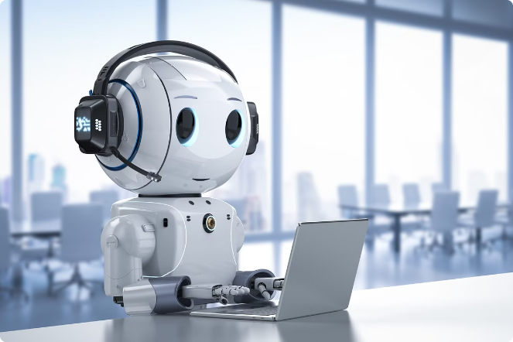



Potential Applications
Chatbots
The model can be integrated into chatbots to provide accurate and informative answers to user queries.
Search Engines
The model can enhance search engines by providing more comprehensive and relevant answers to user searches.
Knowledge Base Systems
The model can be used to build knowledge base systems that answer complex questions from a vast amount of information.
Customer Support
The model can automate customer support by providing quick and accurate responses to common inquiries.

Slide 7


Challenges and Limitations
Data Bias
The dataset may reflect biases present in the real world, potentially leading to biased answers.
Contextual Understanding
The model may struggle to understand complex questions with multiple layers of context.
Handling Ambiguity
The model may find it challenging to provide accurate answers when presented with ambiguous or open-ended questions.

Slide 8


Conclusion and Next Steps
1
Model Deployment
The T5 model will be deployed for use in various applications, leveraging its high accuracy and efficiency.
2
Further Research
Further research will focus on addressing the limitations of the model, including improving its ability to handle complex questions and contextual ambiguity.
3
Model Enhancement
We will explore strategies to enhance the model's performance, such as fine-tuning it on specialized datasets or incorporating advanced NLP techniques.

Slide 9



THANK YOU
Thank you for reviewing this presentation on our Quora question answering project. We covered the key aspects, from the dataset to the NLP models and evaluation. Please let me know if you have any other questions!

